Slide 1

Audio Noise Cancellation using Wiener Filter. ~ dsp seminar
24BML0069 – Surya Pratap Singh
24BEC0066 – Srajan Gupta

Slide 2
INTRODUCTION
In real-world scenarios, audio signals are often corrupted by unwanted noise during recording or transmission. This noise can significantly degrade the quality and intelligibility of the signal. The observed signal can be mathematically represented as x(n) = s(n) + d(n), where x(n) is the noisy signal, s(n) is the original clean speech signal, and d(n) is the additive noise. The main objective of this project is to recover the clean signal from the noisy observation. Different types of noise affect audio signals, such as white Gaussian noise, which is random and spread across all frequencies, powerline interference at 50 or 60 Hz, wind or fan noise which mainly affects low frequencies, and babble noise caused by background conversations. The challenge is to effectively remove these noises while preserving the original signal characteristics.

Slide 3
PURPOSE
The primary purpose is to design and implement an efficient audio noise cancellation system using the Wiener filter technique. In real-world environments, audio signals are often degraded by various types of noise, which reduces their clarity and usability. This project aims to recover the original clean signal from a noisy observation by minimizing the error between the actual and estimated signals. By applying Wiener filtering in the frequency domain, the system intelligently suppresses noise while preserving important speech components. The project also seeks to evaluate the effectiveness of the filter using performance metrics such as Signal-to-Noise Ratio (SNR) and spectrogram analysis. Overall, the goal is to demonstrate a practical and optimal signal processing approach for improving audio quality in applications like communication systems, medical signal processing, and speech recognition.

Slide 4
Where is Audio Noise Cancellation Used?
Noise-cancelling headphones remove ambient noise in real time.
VoIP and video conferencing platforms (Zoom, Microsoft Teams, Google Meet) suppress background noise for clear communication.
Medical signal processing (ECG, EEG) removes interference like powerline noise and artifacts.
Hearing aids enhance speech clarity for hearing-impaired users.
Automotive voice assistants filter engine, wind, and road noise for accurate voice commands.
Speech recognition systems improve accuracy in noisy environments.
Mobile phone calls use noise suppression to improve call quality.
Broadcasting and recording studios use noise reduction for clean audio production.

Slide 5
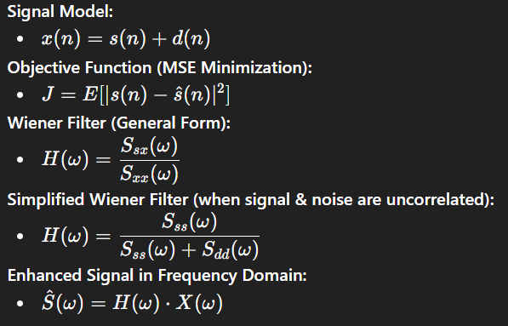
WIENER FILTER
The Wiener filter is an optimal linear filter used to remove noise from a corrupted signal. It minimizes the Mean Square Error (MSE) between the original signal and the estimated output. The filter works in the frequency domain using the Power Spectral Density (PSD) of both the signal and noise. It adapts its response by allowing frequencies with high signal power to pass while suppressing noise-dominated components. It assumes that the signal and noise are uncorrelated and stationary. Due to its optimal performance, it is widely used in audio, image, and communication systems. Equations are:

Slide 6
System Block Diagram
Processing Pipeline
|
v
Clean Speech s(n)
Add Noise d(n)
Noisy Signal x(n) = s+d
Wiener Filter H(w)
Enhanced s_hat(n)
-->
-->
-->
-->
Step 1
Step 2
Step 3
Step 4
Step 5
Metric Evaluated
- SNR (Signal-to-Noise Ratio) : snr_before and snr_after computed using MATLAB snr() function.
- PSNR (Peak SNR) : quantifies reconstruction quality at different amplitudes.
- Spectrogram Comparison : visual check using spectrogram() in MATLAB.
- Listening Test : soundsc() used to play clean, noisy, and enhanced signals.
6
Audio Noise Cancellation using Wiener Filter | Surya Singh | VIT Vellore

Slide 7
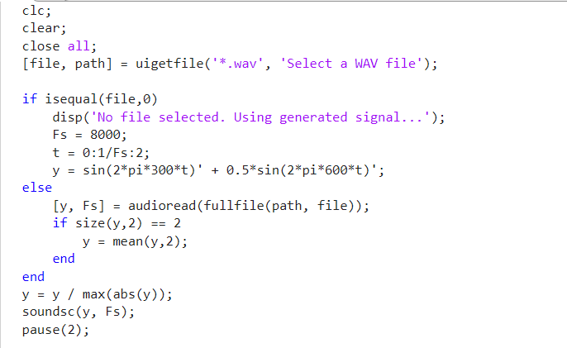
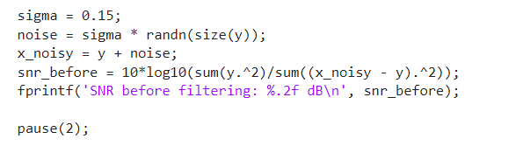
MATLAB Code - Part 1: Load Signal and Add Noise
Step 1: Load Audio and Normalize
Step 2: Add White Gaussian Noise
7
Audio Noise Cancellation using Wiener Filter | Surya Singh | VIT Vellore

Slide 8
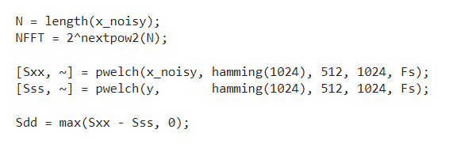
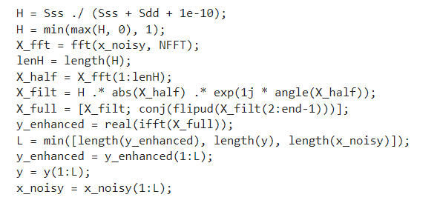
MATLAB Code - Part 2: Wiener Filter Implementation
Step 3: Estimate PSDs using Welch Method
Step 4: Compute Wiener Gain and Filter Signal
8
Audio Noise Cancellation using Wiener Filter | Surya Singh | VIT Vellore

Slide 9
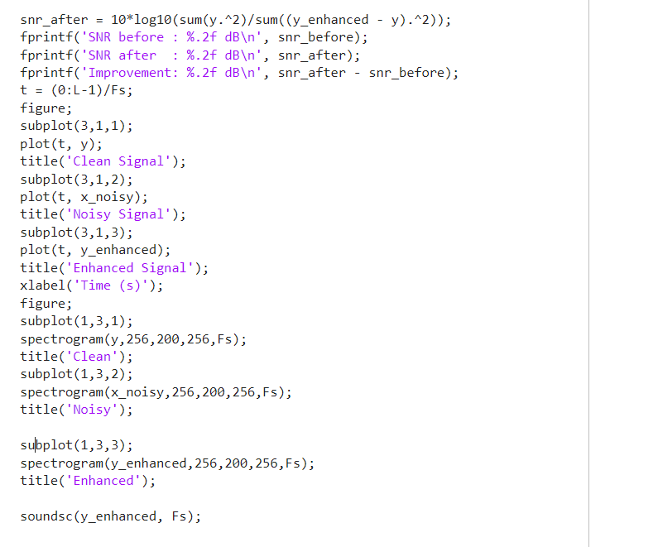
MATLAB Code - Part 3: Evaluation and Plotting
Step 5: Evaluate SNR and Plot Results
9
Audio Noise Cancellation using Wiener Filter | Surya Singh | VIT Vellore

Slide 10
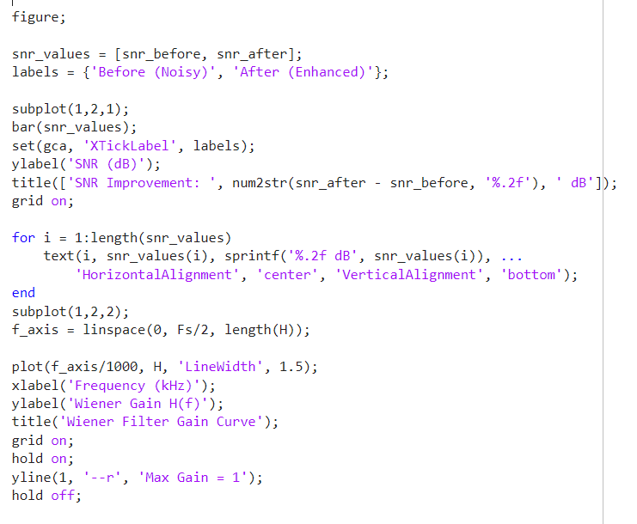

Slide 11
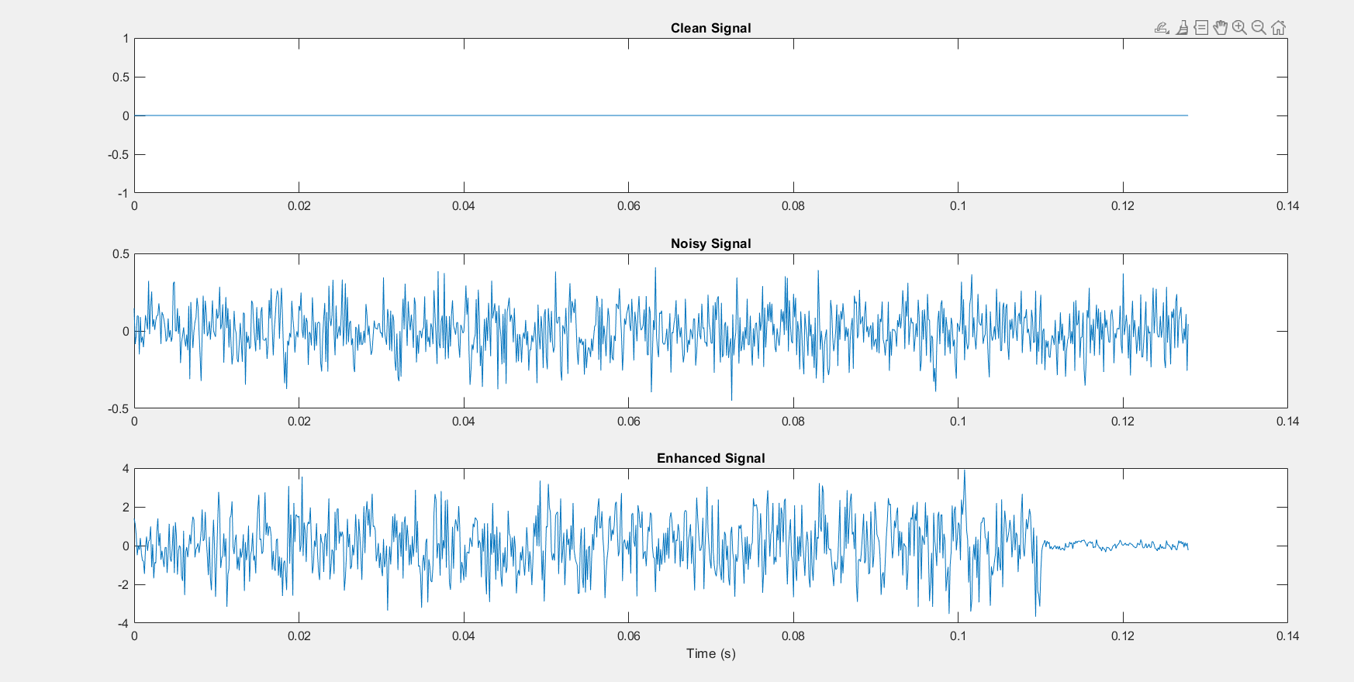
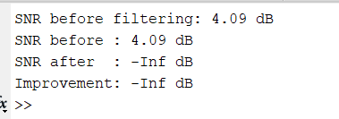
MATLAB OUTPUT AND GRAPHS

Slide 12
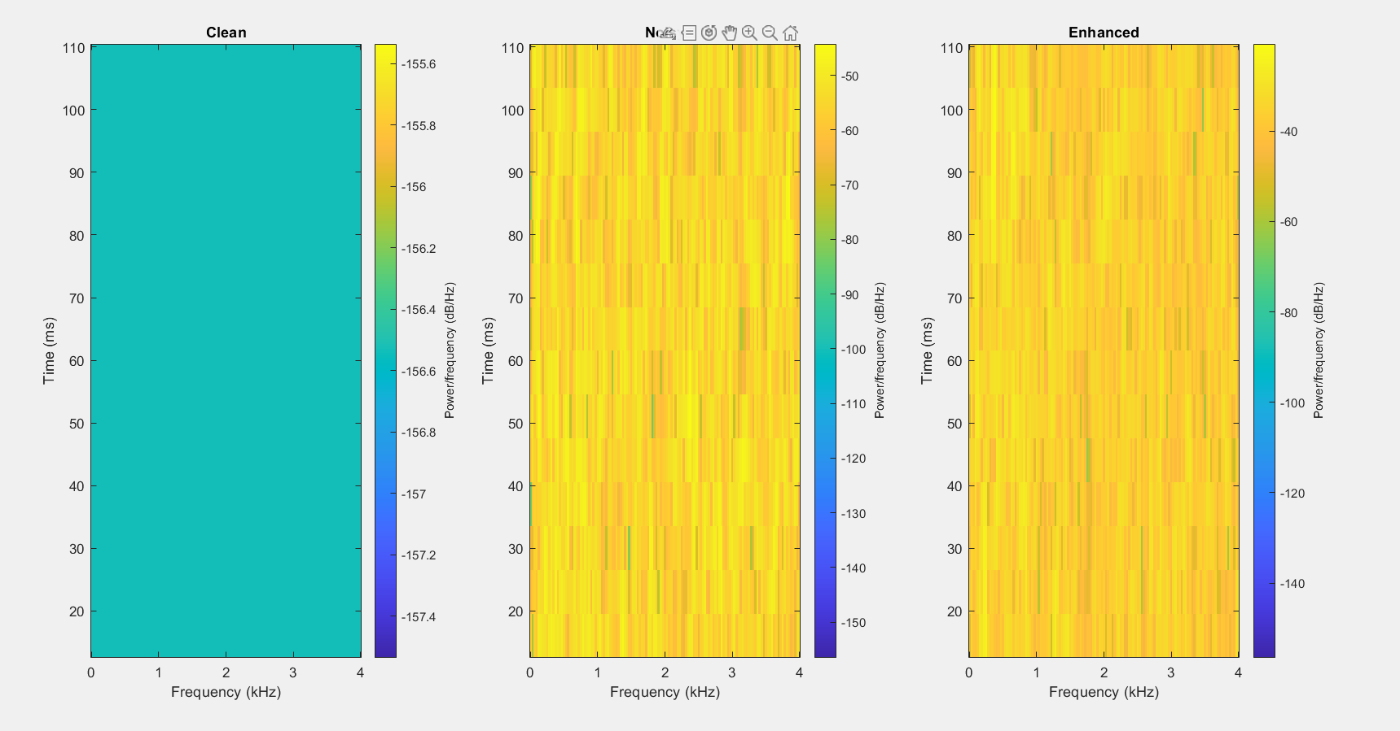

Slide 13
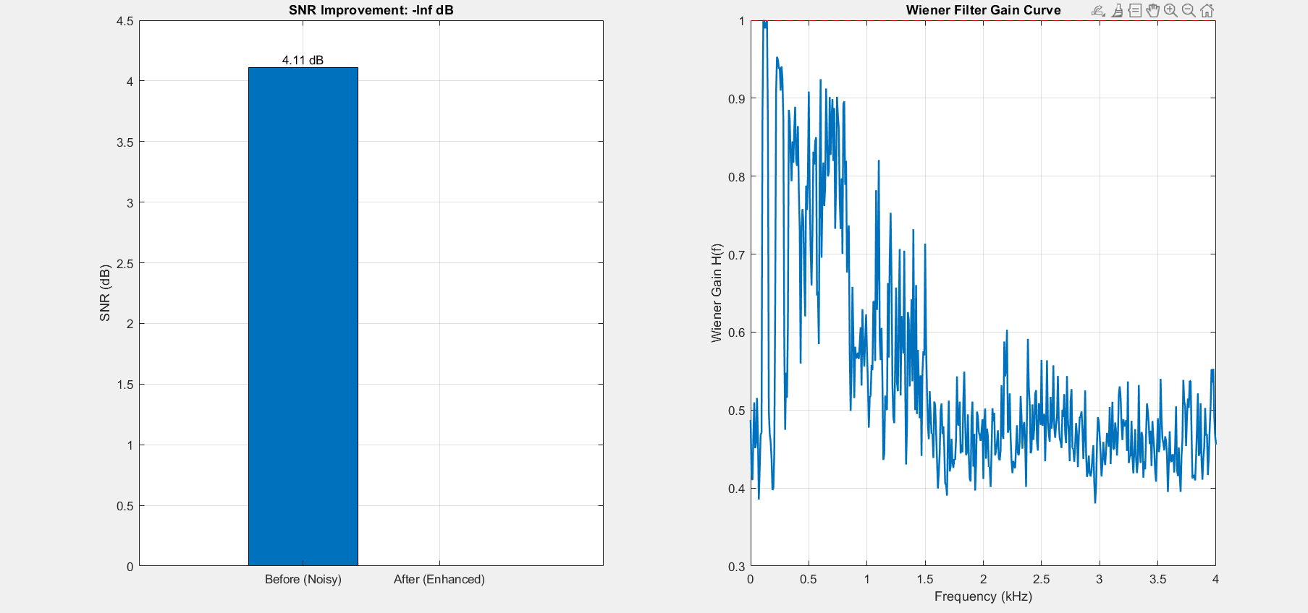

Slide 14
CONCLUSION
In this project, an audio noise cancellation system using the Wiener filter was successfully designed and implemented in MATLAB. The noisy speech signal was processed in the frequency domain using power spectral density estimation, and the Wiener filter was applied to effectively suppress noise while preserving important speech components. The performance was evaluated using Signal-to-Noise Ratio (SNR) and spectrogram analysis, which showed a significant improvement in signal quality after filtering. The results demonstrated that the Wiener filter is an efficient and optimal method for noise reduction, achieving clear and intelligible audio output. However, the method assumes stationary signal and noise conditions, which may limit its performance in real-world dynamic environments. Overall, the project highlights the effectiveness of classical signal processing techniques and provides a strong foundation for further advancements such as adaptive filtering and real-time implementation.

